Slide 1
21st Annual NSPAA Technical Assistance Workshop Series
Expanding Sponsored Programs & Research Possibilities with Contracts: Understanding the Requirements for Success

Slide 2
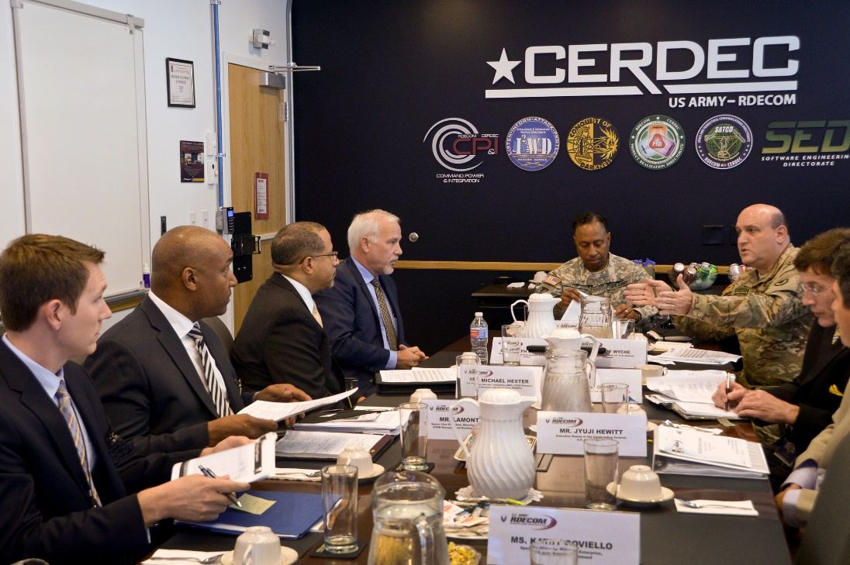
MSI STEM Research & Development Consortium
Consortium developed under the National Defense Authorization Act (NDAA) for FY2010, Section 252
“Establishment of program to enhance participation of historically black colleges and universities and minority serving institutions (HBCU/MI) in defense research programs”
Section 252 program objectives:
enhance the research and educational capabilities of these institutions
encourage their participation in Defense Research, Development, Test & Evaluation (RDT&E)
increase the numbers of graduates engaged in national defense research
encourage research and educational collaboration between these institutions and other institutions of higher education, government defense organizations and the defense industry

Slide 3
MSI STEM Research & Development Consortium
501(c)3 Nonprofit Organization
Began operations in January 2015 with an $86M Cooperative Agreement
Agreement awarded by US Army Research, Development & Engineering Command (RDECOM), Edgewood Chemical & Biological Center (ECBC)
Primary goal to engage MSIs in basic, applied & advanced research for Department of Defense and civilian agencies
Membership of 41 minority serving institutions
Free and open to all MSIs

Slide 4
Significance of the MSRDC Cooperative Agreement
Direct, quick and easy research funding vehicle for government agencies
Introductions to collaborative partners in academia, industry and others
Exposure to congressional level interest in the program
Fast track opportunity to build research capacity and resources
Competition limited to consortium members only
Ability to circumvent traditional competition & negotiate direct awards

Slide 5
How the Consortium Works
Calls for White Papers
Watch for announcements at msrdconsortium.org or fbo.gov
Review Technology Objectives for alignment with your capabilities
Submit a White Paper
If invited, submit a solicited research proposal
Negotiate final award
Business Development Proposals
Understand Federal research funding priorities and the alignment of your capabilities
Identify and develop relationship with technical point of contact
Market your capabilities as solution to POCs technical priorities
Submit concept/white paper and/or research proposal
Negotiate a non-competitive, direct award

Slide 6
The Consortium: Your Opportunity
Funded Research Opportunity
Point of Contact with Funding
Funding Vehicle
Marketable Idea/ Innovation
Government
Your Institution
MSRDC

Slide 7
Our Initial Success
Awarded over $2M for first research projects in the following fields.
Predictive Toxicology
Chemical & Biological Protection
Chemical & Biological Sensing
First projects awarded to the following institutions
Albany State University
City College of New York
Fisk University
North Carolina Agricultural & Technical State University
University of Texas at Rio Grande Valley
North Carolina Central University
University of Texas at San Antonio

Slide 8
Upcoming Opportunities
DARPA Science Forum Webinar – Friday June 10, 2016 at 1:00pm – 3:00pm
Overview of DARPA’s research portfolio
Presentations from the Directors of six of DARPA’s technical offices
Two additional presentations from offices that manage special projects and the transition of funded technologies into DoD capabilities.
Register at www.msrdconsortium.org
Calls for White Papers
Technology Objective | Submission Deadline | Funding Anticipated
Topic #5 through #8: Communications-Electronics Research, Development and Engineering Center (CERDEC) – Multiple Topic Areas | August 1, 2016 | $2M
Topic #1: Models for use in Predictive Toxicology evaluating organophosphate compounds | March 1, 2017 | $1.2M
Topic #2: Science of Chemical and Biological Protection | March 1, 2017 | $800K
Topic #3: Science of Chemical and Biological Sensing | March 1, 2017 | $800K
Topic #4: Smoke and Obscuration Science | March 1, 2017 | Subject to Availability

Slide 9
More Info @ www.msrdconsortium.org

