Slide 1
The Alabama A&M Research, Innovation, Science and Engineering
(AAMU-RISE) Foundation
Overview
Presented at the NPSAA Technical Assistance Workshop
June 7, 2016
AAMU-RISE Foundation
Howard J. Foster Building
4900 Meridian Street North
Normal, AL 35762
www.aamu-rise.org

Slide 2
Overview
The AAMU-RISE Foundation
The Research, Innovation, Science and Engineering Foundation at Alabama A&M University (AAMU-RISE) is established to act as the operation to perform contract-based research and development on behalf of the university.
The AAMU-RISE Foundation works with companies seeking government contracts where there is an HBCU requirement.
The AAMU-RISE Foundation sits within the government/private industry business ecosystem in the greater Huntsville area (NASA Marshal Spaceflight Center, AMRDEC, Missile Defense Agency, etc.)
AAMU-RISE Foundation
Howard J. Foster Building
4900 Meridian Street North
Normal, AL 35762
www.aamu-rise.org

Slide 3
Community Network
AAMU-RISE
AAMU
Regional Partners
SGT, Jacobs, Boeing, Calibre, Lockheed, Other Universities
AMIE
(Advancing Minority’s Interest in Engineering)
15 HBCUs with ABET accredited Engineering Programs
Government Partners
AAMU-RISE Foundation
Howard J. Foster Building
4900 Meridian Street North
Normal, AL 35762
www.aamu-rise.org
NASA, MDA, AMRDEC, ONR, ORNL

Slide 4
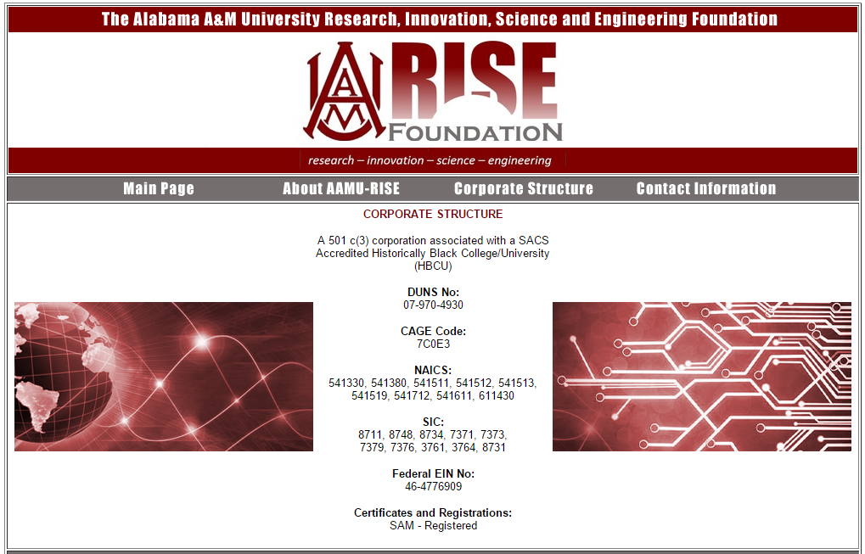
Overview
www.aamu-rise.org
Visit: www.aamu-rise.org
AAMU-RISE Foundation
Howard J. Foster Building
4900 Meridian Street North
Normal, AL 35762
www.aamu-rise.org

Slide 5
Purpose
What We Do
Partner to efficiently and effectively respond to a broad range of task orders. AAMU-RISE provides:
High-level research and development (includes SBIR/STTR)
Qualified personnel
Project management experience/expertise
Facility security clearance in place for AAMU
AAMU-RISE Foundation
Howard J. Foster Building
4900 Meridian Street North
Normal, AL 35762
www.aamu-rise.org

Slide 6
Goals and Strategy
Create a GSA schedule
Become a prime contractor with NASA and DoD
Establish the AAMU-RISE brand with government agencies and primes
Integrate research activities into student outcomes
AAMU-RISE Foundation
Howard J. Foster Building
4900 Meridian Street North
Normal, AL 35762
www.aamu-rise.org

Slide 7
Technical Capabilities
Research and Development
Next generation technologies (Additive Manufacturing, etc.)
Internationally recognized researchers
World-class laboratory facilities
State-of-the Art Laboratory Facilities
Mach 4 Supersonic Wind Tunnel Testing and Evaluation Center
Microelectronics Fabrication Facilities
Surface Analysis Laboratory
Electrical Characterization Laboratory
Tandem Accelerators (Pelletron & Tandetron)
Cyber Security
Clean Room
AAMU-RISE Foundation
Howard J. Foster Building
4900 Meridian Street North
Normal, AL 35762
www.aamu-rise.org

Slide 8
Past Performance and Contracts
Organization Contract Number Prime Contract
Calibre MP support L0148-15-139 W9113M-14-C-0033
SGT ISRDS2 SC15-00035 NNA14AA60C
Boeing MOKV 1155427 HQ0147-15-C-0014
Torch T15S004 W31P4Q-09-A-0021, TO #9
MDA HA0147-14-C-6002 HA0147-14-C-6002
Redlen Service Agreement -
Jacobs ESSSA ESSSA-068 NNM12AA41C
MEI S-04263-13-0017 4263-030216-02
BNL 300178-Service Agreement -
Morningbird Media MBMC-1001-A001 NNX16CM40P
AAMU-RISE Foundation
Howard J. Foster Building
4900 Meridian Street North
Normal, AL 35762
www.aamu-rise.org

Slide 9
The Knowledge Sharing Center
The Knowledge Sharing Center (KSC) will enable Historically Black Colleges, Universities, (HBCUs) and Minority Serving Institutions (MSIs) to achieve better acquisition outcomes in Federal procurement by developing long-term partnerships with federal agencies and the private sector.
AAMU-RISE Foundation
Howard J. Foster Building
4900 Meridian Street North
Normal, AL 35762
www.aamu-rise.org

Slide 10
The Knowledge Sharing Center
Scope
KSC will provide training and lessons learned in the area of acquisition management to the Universities but also educate the private sector on why it is important to do business with HBCU’s/MI’s. The center will be connected to a workflow learning concept that will involve three critical areas:
Regulatory compliance (FAR based)- teaching.
Performance-based learning (which will be lessons learned from private industry)
Contract management
AAMU-RISE Foundation
Howard J. Foster Building
4900 Meridian Street North
Normal, AL 35762
www.aamu-rise.org

Slide 11
The Knowledge Sharing Center
Workflow Process
Leadership Coaching
Leadership-level Acquisition Courses
Mission Assistance
Requirements Management Training
KNOWLEDGE SHARING CENTER
Leadership-level Acquisition Courses
COURSE TRAINING
Pursue government contracts
Senior Leaders in academia
Private Industry Leaders
(KSC) Establishment
Ensure
Government
Contract Interest
Educate the Government
10 U.S. Code § 2323
AAMU-RISE Foundation
Howard J. Foster Building
4900 Meridian Street North
Normal, AL 35762
www.aamu-rise.org
Receive Educational training on Small Disadvantage Businesses and Unrepresented Academic Institutions
DOD INTERIM RULE
HBCU and Minority extent

Slide 12
The Knowledge Sharing Center
Objective
Expand the knowledge base and training of senior leaders in academia and private industry to support the mission of acquiring contract based awards while continuing to receive grants.
Leadership-level Acquisition Courses
Requirements Management Training
Acquisition Leadership Training
Leadership Coaching
Mission Assistance
KNOWLEDGE SHARING
AAMU-RISE Foundation
Howard J. Foster Building
4900 Meridian Street North
Normal, AL 35762
www.aamu-rise.org

Slide 13
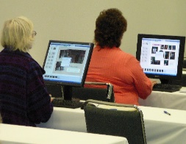
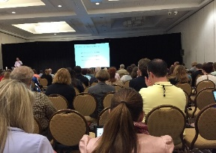
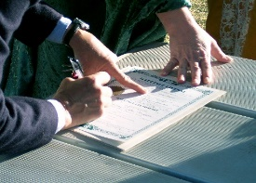
The Knowledge Sharing Center
Training Courses
Knowledge Sharing Online portal knowledge sharing
AAMU-RISE online collaborative communities
Knowledge Repository - Online connection to partners, coaches and acquisition research resources
Training
Classroom & Online Targeted Training - Tailored organizational training
REAL-TIME TRAINING - On-site & online training on the latest policies in government contracting
Continuous Learning
CL Modules - Online, self-paced learning modules
Conferences – HBCU/MI Acquisition Community Training Symposium, Hot Topic Forums
AAMU-RISE Foundation
Howard J. Foster Building
4900 Meridian Street North
Normal, AL 35762
www.aamu-rise.org
Mission Assistance
Consulting - Helping organizations solve complex acquisition problems Team Training – Services Acquisition Workshops,
Leadership Coaching – For Academia Leaders and Partner Government Contractor

Slide 14
The Knowledge Sharing Center
Supporting Education and Government Agency Success
10 U.S. Code § 2323 - Contract goal for small disadvantaged businesses and certain institutions of higher education is no longer a requirement
Contract goal for small disadvantaged businesses and certain institutions of higher education
(a) Goal.-(1) Except as provided in subsection (d), a goal of 5 percent of the amount described in subsection (b) shall be the objective of the Department of Defense, the Coast Guard, and the National Aeronautics and Space Administration in each fiscal year for the total combined amount obligated for contracts and subcontracts entered into with-
(A) small business concerns, including mass media and advertising firms, owned and controlled by socially and economically disadvantaged individuals (as such term is used in section 8(d) of the Small Business Act (15 U.S.C. 637(d)) and regulations issued under that section), the majority of the earnings of which directly accrue to such individuals;
(B) historically Black colleges and universities, including any nonprofit research institution that was an integral part of such a college or university before November 14, 1986; and
(C) minority institutions (as defined in section 1046(3) of the Higher Education Act of 1965 (20 U.S.C. 1135d–5(3)),¹ which, for the purposes of this section, shall include Hispanic-serving institutions (as defined in section 316(b)(1) of such Act (20 U.S.C. 1059c(b)(1)).¹
AAMU-RISE Foundation
Howard J. Foster Building
4900 Meridian Street North
Normal, AL 35762
www.aamu-rise.org

Slide 15
The Knowledge Sharing Center
DoD Interim Rule
SUMMARY:
DoD issued an interim rule effective October 14, 2014 amending the Defense Federal Acquisition Regulation Supplement (DFARS) to remove language based on 10 U.S.C. 2323. The action was necessary because it had expired.
AAMU-RISE Foundation
Howard J. Foster Building
4900 Meridian Street North
Normal, AL 35762
www.aamu-rise.org

Slide 16
The Knowledge Sharing Center
How HBCUs/MSIs are Affected in DoD
The following is a summary of the revisions to the DFARS: --
Removal of DFARS 205.207(d) subparagraphs (i) and (ii), which provided guidance for synopsizing HBCU and MI set-asides, and update the PGI reference in subparagraph (iii). [[Page 61580]] --Removal of DFARS 206.203, which provided guidance pertaining to HBCU and MI set-asides under the authority of 10 U.S.C. 2323;
--Revision of DFARS 215.304 to (1) Remove the references to HBCUs and MIs and (2) add language to clarify the extent of small business participation in performance of the contract that shall be addressed during source selection for acquisitions requiring subcontracting plans.
AAMU-RISE Foundation
Howard J. Foster Building
4900 Meridian Street North
Normal, AL 35762
www.aamu-rise.org

Slide 17
The Knowledge Sharing Center
Key Purposes of the KSC
To ensure the HBCU/MSI’s are motivated to pursue government contracts.
To ensure Government Contractors are interested in partnering with HBCU/MSI’s to achieve the maximum SDB goals and to achieve awards using the Lowest Price Technically Acceptable Method (LPTA)
Educate the government on the capabilities of the universities for contract work.
AAMU-RISE Foundation
Howard J. Foster Building
4900 Meridian Street North
Normal, AL 35762
www.aamu-rise.org

Slide 18
The Knowledge Sharing Center
AAMU-RISE Foundation
Howard J. Foster Building
4900 Meridian Street North
Normal, AL 35762
www.aamu-rise.org

Slide 19
The Knowledge Sharing Center
AAMU-RISE Foundation
Howard J. Foster Building
4900 Meridian Street North
Normal, AL 35762
www.aamu-rise.org

Slide 20
Conclusion
The AAMU-RISE Foundation was established just over a year ago and has enjoyed initial success due to the efforts of an aggressive team and leveraging the need for agencies and prime contractors to do business with HBCUs.
Successful teaming agreements have been established and implemented with diverse primes.
We are establishing strong relationships with the contract community in order to grow current contracts and establish new ones.
We are working to share the knowledge of seeking and performing contract-based R&D with the HBCU/MSI community.
AAMU-RISE Foundation
Howard J. Foster Building
4900 Meridian Street North
Normal, AL 35762
www.aamu-rise.org

Slide 21
Thank you
The AAMU-RISE Foundation
Howard J. Foster Building
4900 Meridian Street North
Normal, AL 35762
www.aamu-rise.org
Dr. Chance M. Glenn, Sr.
President/Executive Director
chance.glenn@aamu-rise.org
Dr. Del Smith
Director – Operations
del.smith@aamu-rise.org
Dr. Paul Ruffin
Chief Scientist
paul.ruffin@aamu-rise.org
Ms. Patricia McDonald
Contract Officer
patricia.mcdonald@aamu-rise.org
Mr. Babatunde Obembe
Finance and Administrative Officer
babatunde.obembe@aamu-rise.org

