Slide 1
The Tobacco-Free Historically Black Colleges and Universities Initiative

Slide 2
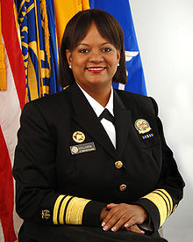
THE INITIATIVE
First of its kind to develop and implement smoke- or tobacco-free campus policies on all Historically Black Colleges and Universities (HBCUs)
A multi-organizational collaborative project led by Former U.S. Surgeon General Dr. Regina Benjamin
Legacy has established this initiative, with our partners, as an opportunity to take action in tobacco control efforts focused on youth and young adults

Slide 3
PARTNERS
Delta Sigma Theta Sorority, Inc.
American Legacy Foundation (Legacy)
African American Tobacco Control Leadership Council (AATCLC)
Americans for Nonsmokers Rights Foundation (ANRF)
Campaign for Tobacco Free Kids (CTFK)
The Louisiana Campaign for Tobacco Free Living (TLCTFL)
NAATPN, Inc.(formerly National African American Tobacco Prevention Network)
Tobacco Control Network (TCN)
U.S. Department of Health and Human Services (Office of Surgeon General and Office of the Asst. Secretary for Health)

Slide 4
Why Focus on Tobacco?

Slide 5
Tobacco is the #1 killer of african americans
EVERY YEAR
Homicides kill 8,650
Tobacco kills 47,300
Notes:
African Americans bear a disproportionate burden of tobacco-related diseases and death, when compared to the general population.
Tobacco kills 47,300 African Americans every year, more than violence, AIDS, and car accidents COMBINED
Does not take into account the numbers who have died as a result of exposure to secondhand smoke.

Slide 6
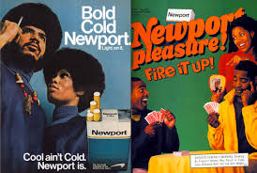
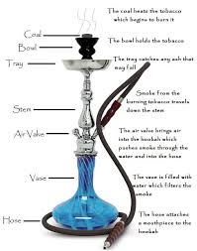
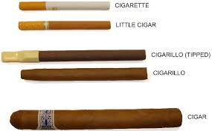
The products
Menthol products have been advertised to the African American community for decades
African American youth are heavily using fruit flavored little cigars and cigarillos
During a typical 1-hour hookah session, a person may inhale as much smoke as smoking 100 cigarettes
Notes:
Mentholated products have been advertised to the African American community for years. The menthol flavor makes the smoke easier to inhale, thus reducing the smoker’s perception of harming their bodies. Menthol cigarettes contain higher amounts of tar and nicotine than non-mentholated cigarettes; menthol cigarette are also associated with increased nicotine dependence and lower quit rates. Additionally, smoking menthol cigarettes may further increase the smoker’s exposure to tobacco toxins and cancer causing substances.
Health statistics reflect that AA youth are increasingly using fruity flavored cigs and LCCs. Upswing increases have been noted in past 2 yrs plus.
Hookah is becoming increasing popular amongst all college students - including AA college students. Many mistakenly believe that inhaling tobacco via a water pipe is safer - but instead a person actually inhales an amount equivalent to smoking 100 cigs.
Fruit flavored (i.e. grape, apple, and peach)

Slide 7
well-being of African Americans threatened by tobacco
African Americans bear a disproportionate burden of tobacco-related diseases and death compared to the general population
67% of overall health disparities in mortality related to high smoking prevalence of African American men
African American youth/young adults are among the biggest consumers of menthol cigarettes, flavored little cigars & cigarillos
Notes:
Some additional facts shown here:
African Americans bear a disproportionate burden of tobacco-related diseases and death, when compared to the general population.
Death rates are higher
And we are big consumers

Slide 8
Why Tobacco- Free HBCUs?
Notes:
Need a new section title

Slide 9
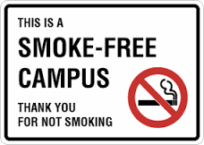
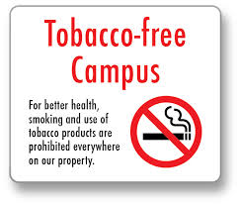
CURRENT POLICY STATUS – HBCUs
Of the 105 HBCUs, 36 have comprehensive tobacco- or smoke-free campus policies
Comprehensive policies vs. designated smoking areas
Anything less than comprehensive results in continued exposure to second hand smoke
Let’s keep the momentum going!!! 73 schools to go!

Slide 10
HBCUs with Comprehensive Smoke-Free or Tobacco-Free Policies
Alabama State University
Albany State University
Allen University
Barber-Scotia College
Bennett College for Women
Bethune-Cookman University
Central State University
Claflin University
Clinton College
Coppin State University
Delaware State University (3 campuses)
Dillard University
Edward Waters College
Grambling University
Harris-Stowe University
Huston-Tillotson University
J.F. Drake Technical College
Johnson C. Smith University
Kentucky State University
Langston University at Langston
Langston University at Oklahoma City
Lincoln University
Morehouse School of Medicine
Oakwood University
Paul Quinn College
Southern University and A&M College
Southern University at Baton Rouge
Southern University Law Center
Southern University at New Orleans
Southern University at Shreveport
Stillman College
Tuskegee University
University of Arkansas at Pine Bluff
Voorhees College
Xavier University at New Orleans
Notes:
If you have ties to an HBCU and it’s not on this list, we need your help!

Slide 11
Why the initiative is important
Our students
Promote a healthy campus environment for students, faculty, staff, and administrators to live, work and learn
Creating a norm for our next generation
Our surrounding communities
Tobacco-free policies are trending….
just not on HBCU campuses
Notes:
This initiative is important because it allows the next generation to lead the effort to reduce the burden of death and disease, from an industry that has targeted the Black community for decades.
African American students attending HBCUs are of lower-socioeconomic status compared to their counterparts that attend predominantly white institutions.
Several HBCUs are located in low-income communities where tobacco industries are actively present and tobacco products(menthol and little cigars) are readily accessible and available.
A study by Legacy published in the American Journal of Public Health found that little cigars and cigarillos are more available, significantly cheaper and more likely to be advertised on the exteriors of retail outlets and on billboards in African-American neighborhoods.

Slide 12
INITIATIVE APPROACH: PILOT PHASE
Pilot Phase (Spring, 2015) : Invited institutions received $3000 from Legacy in grant support to advocate for, adopt, and implement a 100% smoke-free or tobacco-free college policy. Conducted focus groups for learning purposes.
Fisk University
Livingstone College
Shaw University
Shorter College
Talladega College

Slide 13
INITIATIVE APPROACH: FULL PHASE
This Spring, Legacy recruited for the first cohort of grantees. Programming commences Sept 1, 2015
Technical Assistance
  $5,000 grants
  Program and communications toolkits
  Gear
  Training events
  Webinars
  In-person site visits and consultative assistance
  Sample and model policies

Slide 14
Initiative Approach: Spring 2016
This Fall, Legacy will begin recruiting and re-open the applications for a second cohort in August, 2015
Deadline: mid October, 2015
Project Elements:
  Form a college taskforce
  Assess
  Educate and engage
  Identify a plan to address tobacco treatment
  Develop a policy recommendations
Technical Assistance
  $5,000 grants
  Program and communications toolkits
  Gear
  Training events
  Webinars
  In-person site visits and consultative assistance
  Sample and model policies

Slide 15
FOR MORE INFORMATION, CONTACT
Denise Smith, MPH
Legacy
202-454-5552 SmokeFreeHBCU@legacyforhealth.org

Slide 16
QUESTIONS?
THANK YOU!

